Slide 1
MEDICAL PHYSICS AND BIOMEDICAL ENGINEERING
Deep transfer learning for video-telemetry
^{and MRI processing in epilepsy}
Fernando Pérez-García, Rachel Sparks, John Duncan, Sébastien Ourselin
EPSRC Centre for Doctoral Training in Intelligent, Integrated Imaging In Healthcare (i4health)
MPhil upgrade day
19 February 2020

Slide 2
^{Background}
⅓ epilepsy patients are drug-resistant
Tests: MRI, video-telemetry, EEG...
Epileptogenic zone → resection
40 to 70% success* rate
Clinical observations → resection
Clinical outcome
*one year seizure-freedom

Slide 3
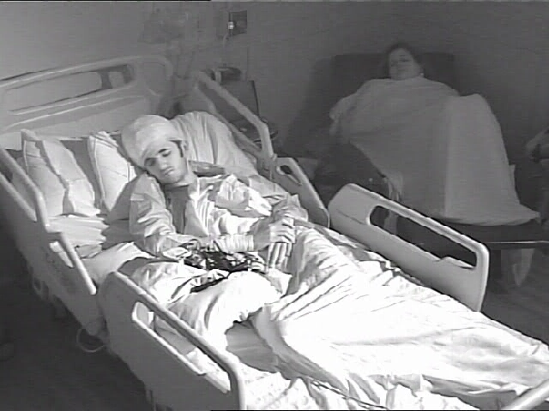
^{Motivation - video-telemetry}
Trained neurophysiologist
Seizure semiology
Videos are days long
Sheets, nurses, bandages...
Intra- and inter-rater variability

Slide 4
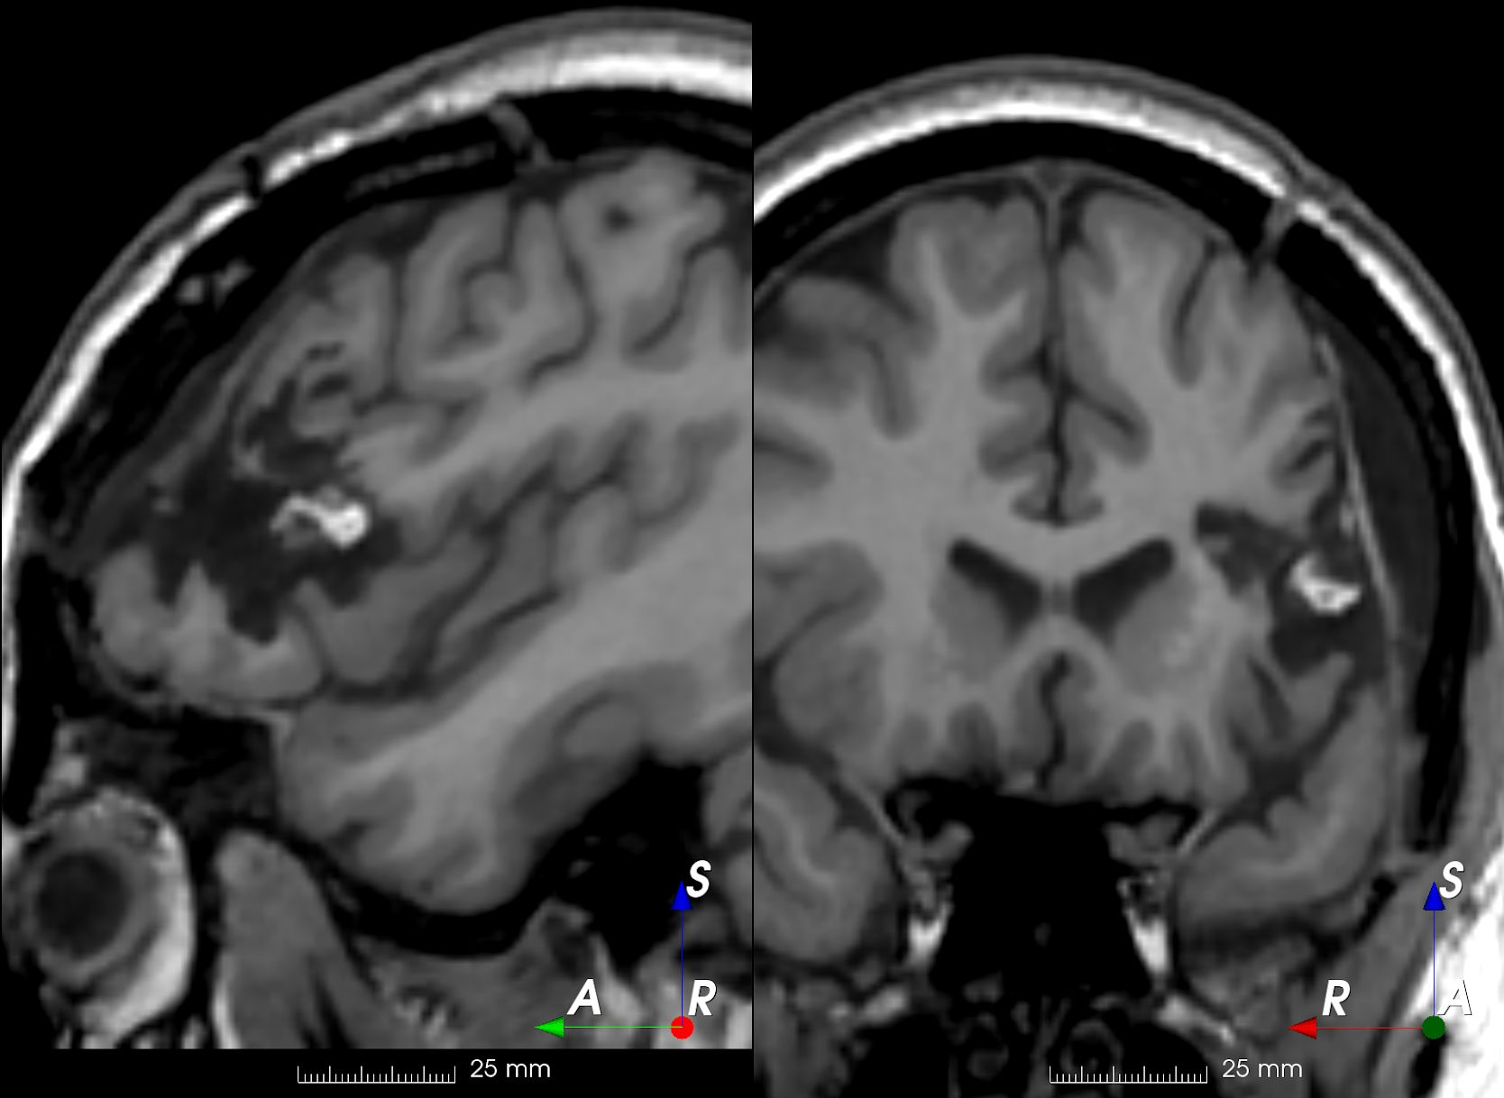
^{Motivation - resective surgery}
Lobe-wise labelling
“Left frontal lobectomy”
Pixel-wise labelling
Trained neuroradiologist
3D images
Intra- and inter-rater variability

Slide 5
^{Methods - deep learning}
Deep learning is very successful
It doesn’t work!
Massive amounts of (labelled) data
Patients need privacy
Labelling needs time and expertise

Slide 6
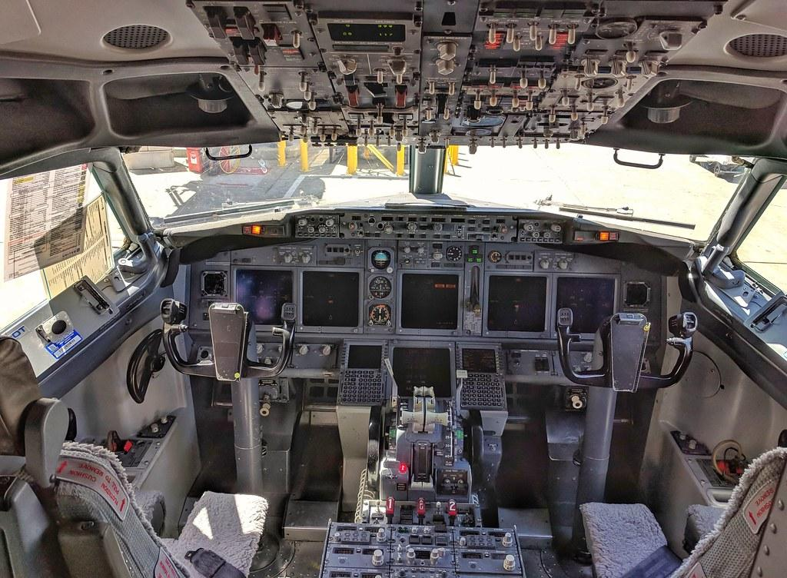
^{Methods - transfer learning}

Slide 7
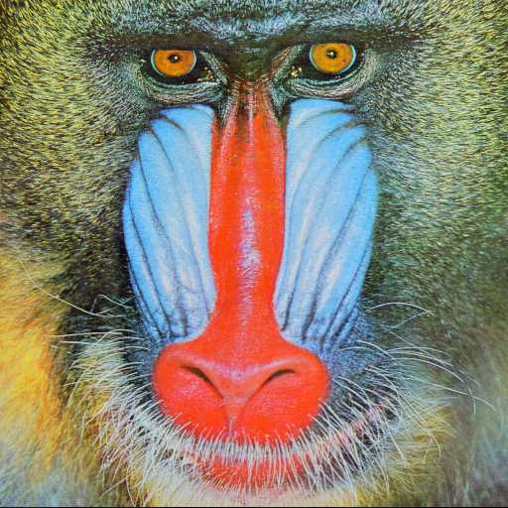
^{Methods - machine learning}
y = “mandrill”
y = “mandrill”
?
ŷ = f(x) = “baboon”
x

Slide 8
Methods - self-supervised learning
x_{r} = “To be or not to be, that is the question”
x = “To be or not to be, that is the question”
y_{r} = “To be or not to be, that is the question”
ŷ = f(x) = “To be or not to have, that is the question”

Slide 9
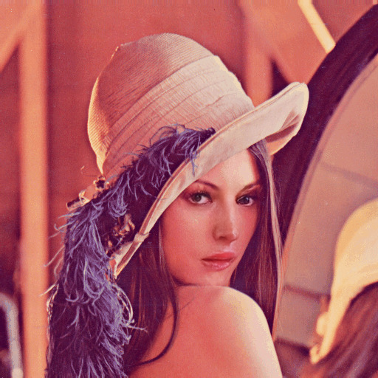
Methods - self-supervised learning
x_{r}
y_{r}
x
ŷ = f(x)

Slide 10
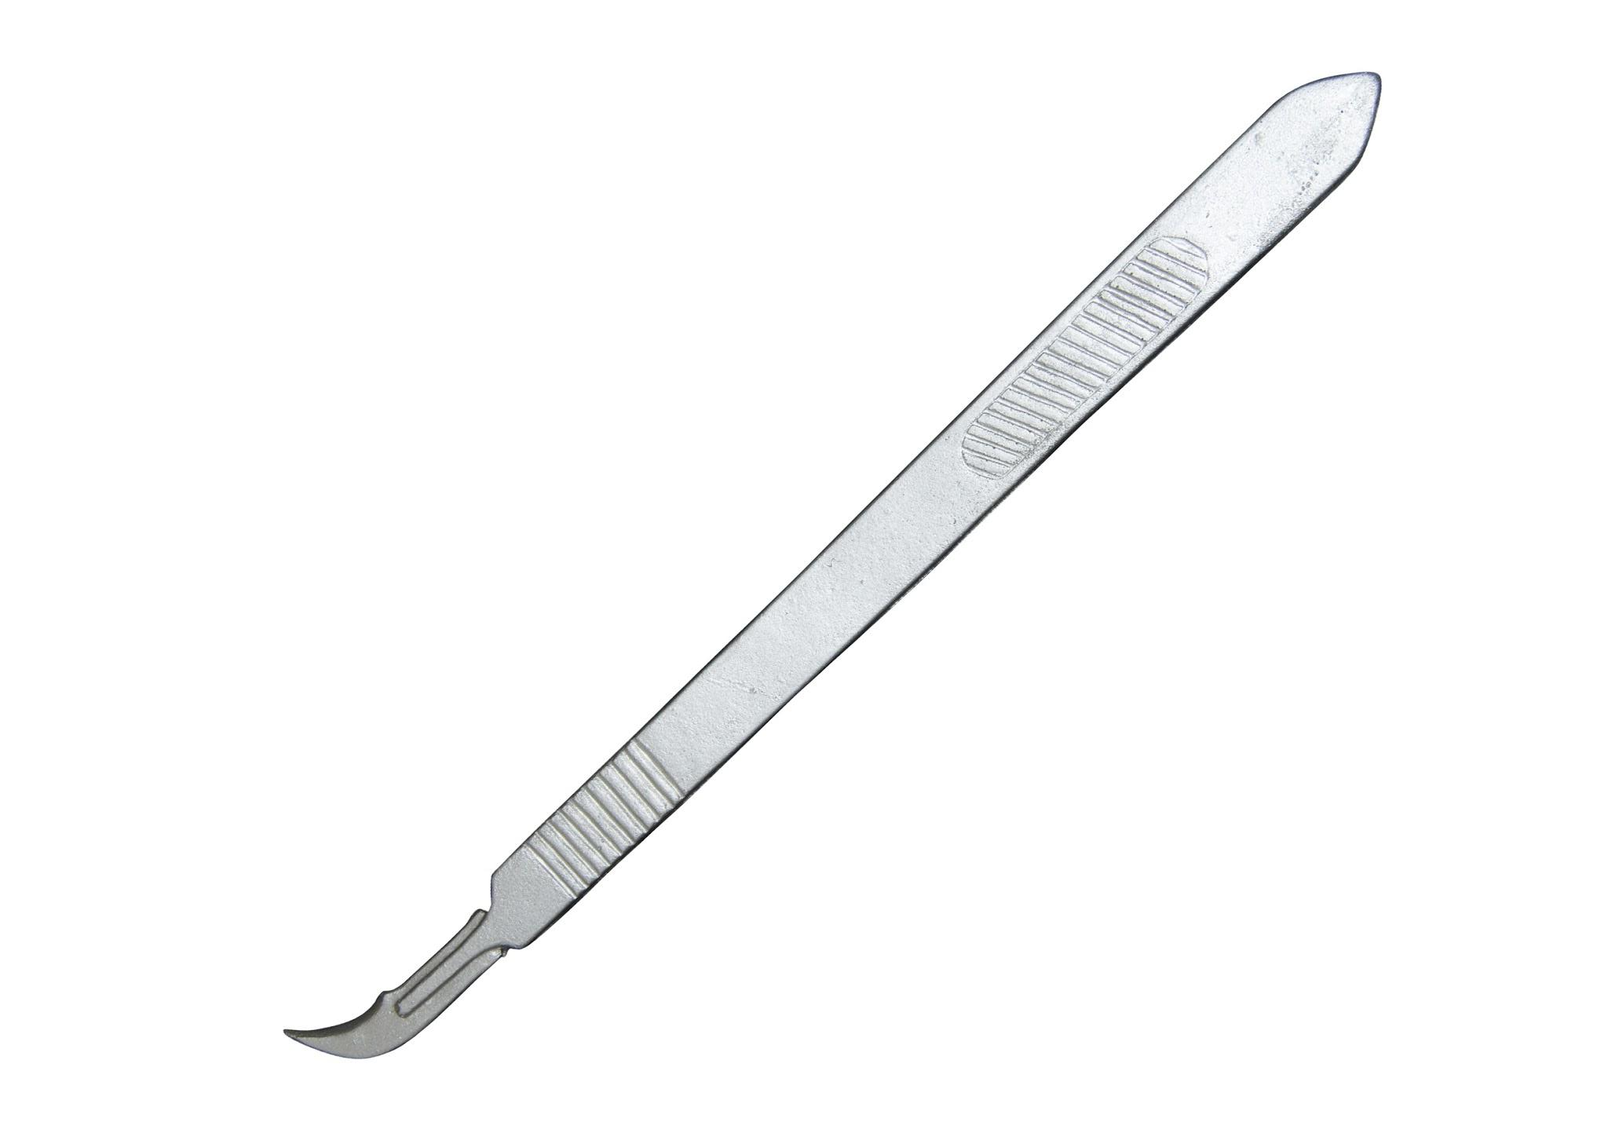
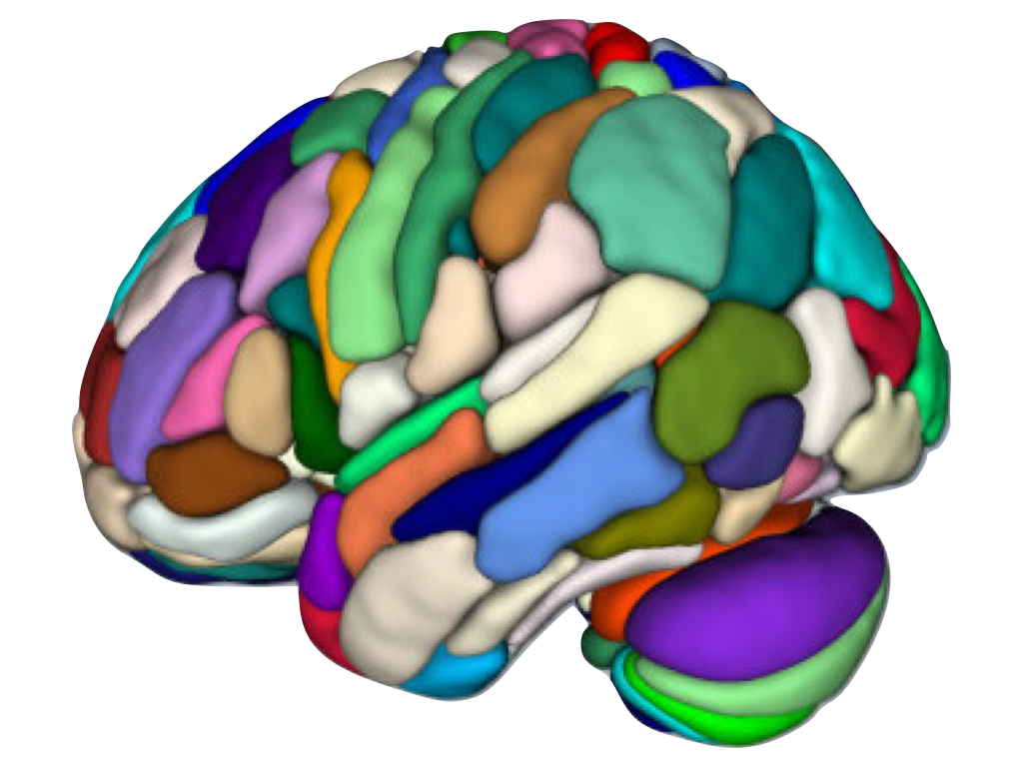
^{Methods - synthetic resection}
Preop brain x
Resected brain x_{r}
Resection model*
Preoperative parcellation
Resected label y_{r}
Parcellation model
*https://github.com/fepegar/resector

Slide 11
Methods - semi-supervised learning
Adapted from Fabien Lotte, 2015, Signal Processing Approaches to Minimize or Suppress Calibration Time in Oscillatory Activity-Based Brain–Computer Interfaces

Slide 12
^{Data - EPISURG}
430 patients with resective surgery
National Hospital for Neurology and Neurosurgery, Queen Square
1990 - 2018

Slide 13
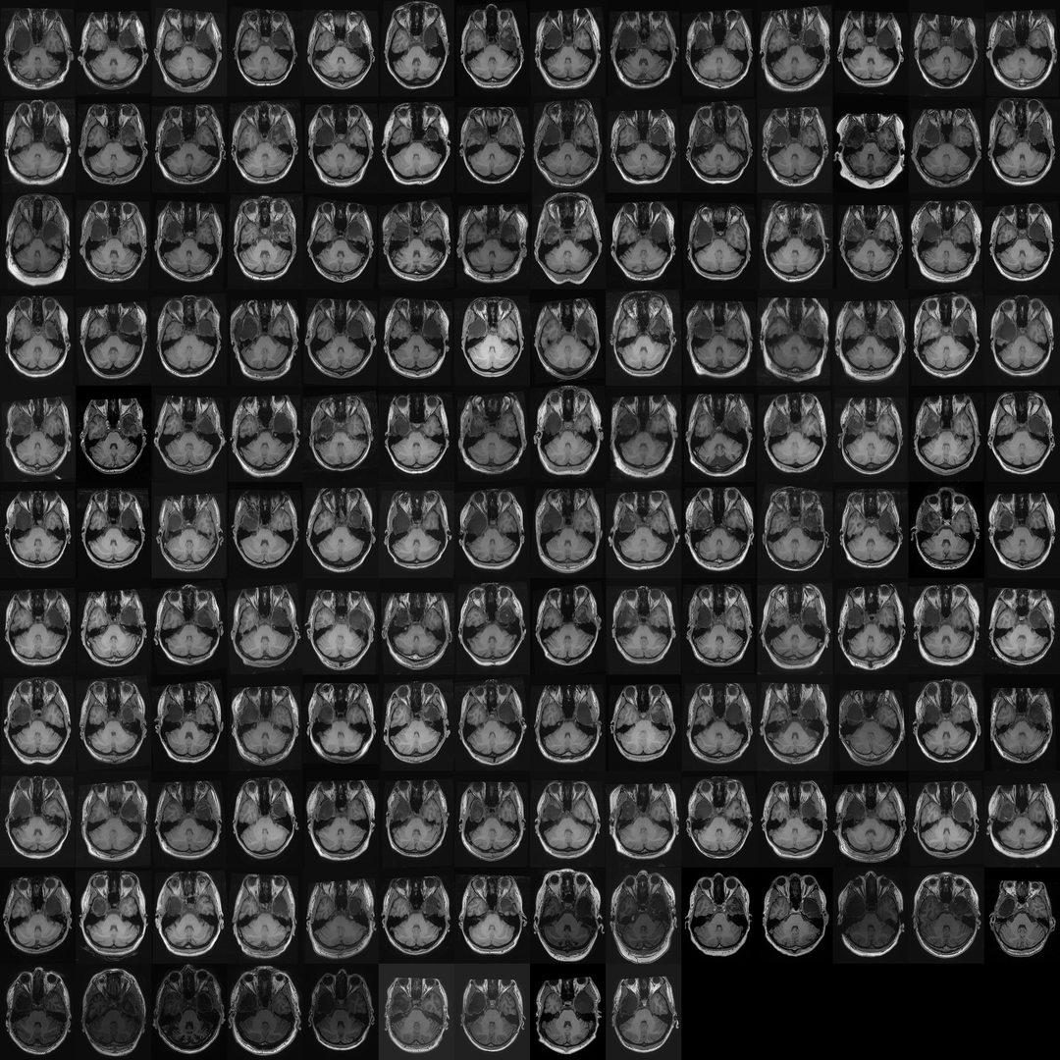
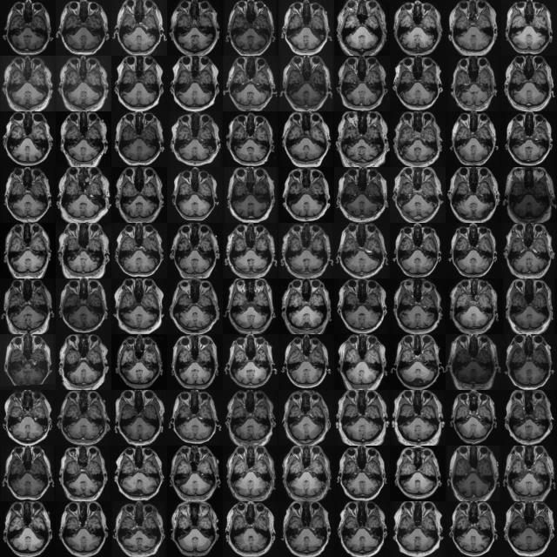
Preoperative (no resection)
EPISURG dataset
^{Data - all}
EPISURG postop
labelled
(133)
EPISURG preop
(261)
EPISURG postop
unlabelled
(297)
Publicly available data
(1813)

Slide 14
^{Experiments}
EPISURG postop labelled | EPISURG postop unlabelled | EPISURG preop (unlabelled) | Public (unlabelled) | TOTAL
133 (10-fold CV) |  |  |  | 133
 |  | 261 |  | 261
 |  |  | 261 | 261
 |  |  | 1813 | 1813
 |  | 261 | 1555 | 1813
 |  | 261 | 1813 | 2074
 | 297 | 261 | 1813 | 2371

Slide 15
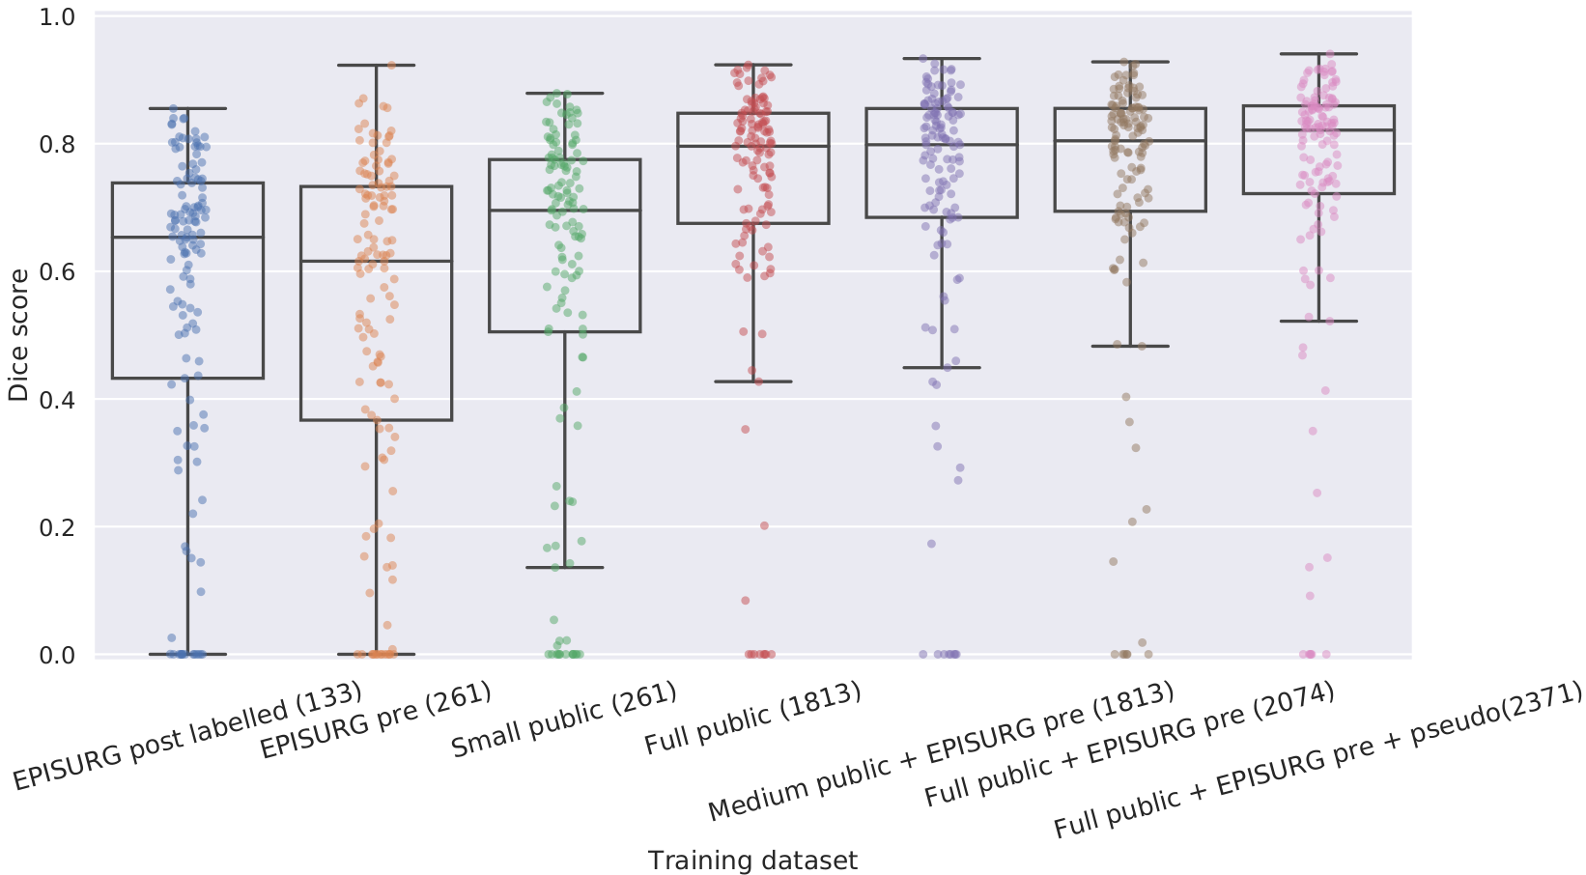
^{Results - quantitative}

Slide 16
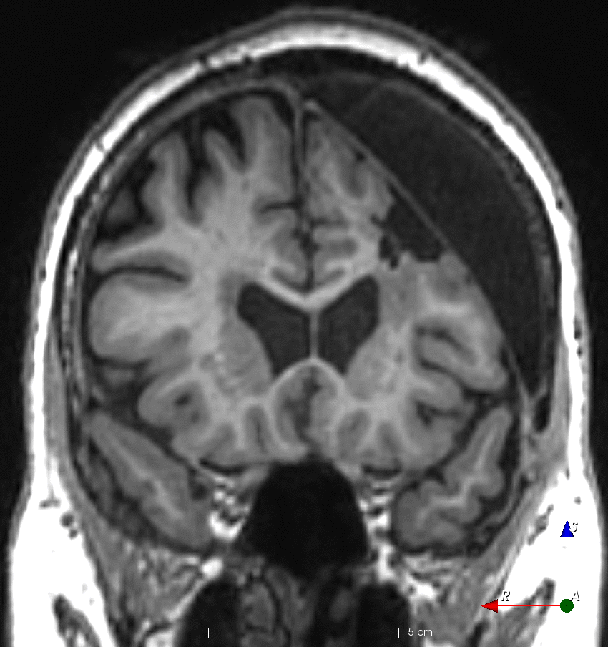
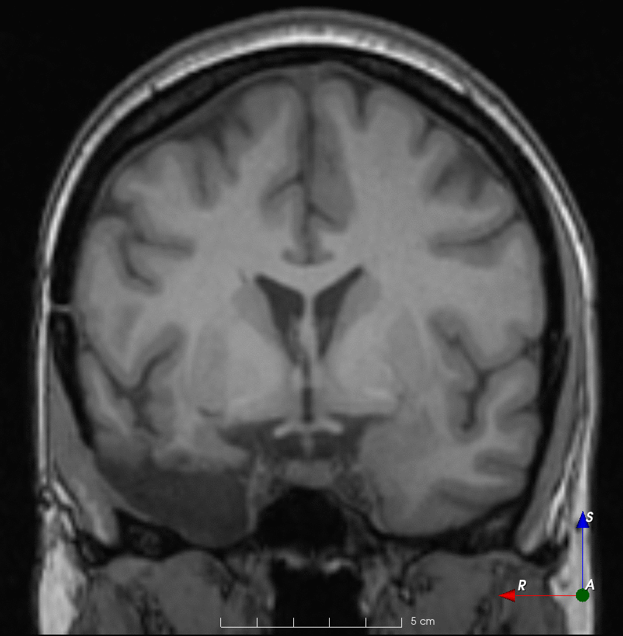
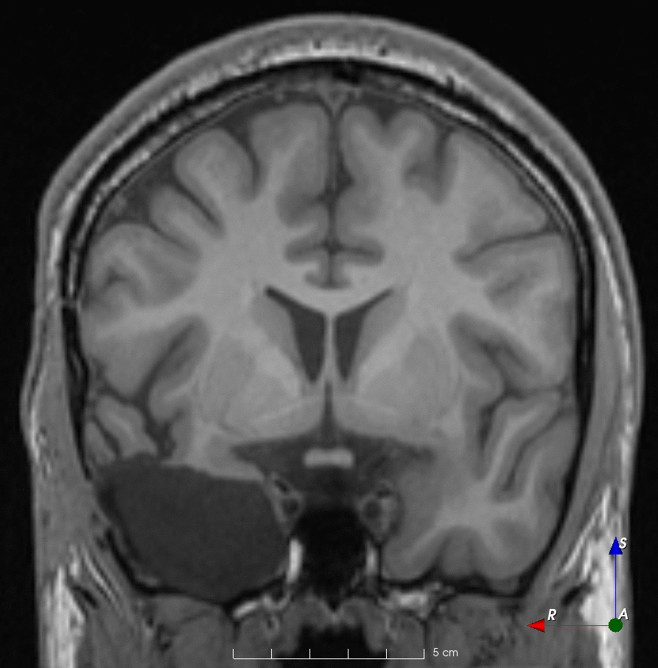
Label
Prediction
^{Results - qualitative}
Worst > 0
DSC 0.09
(4.5th percentile)
Median
DSC 0.82
Best
DSC 0.94
Notes:
Worst 1168
Median 0481
Best 0495

Slide 17
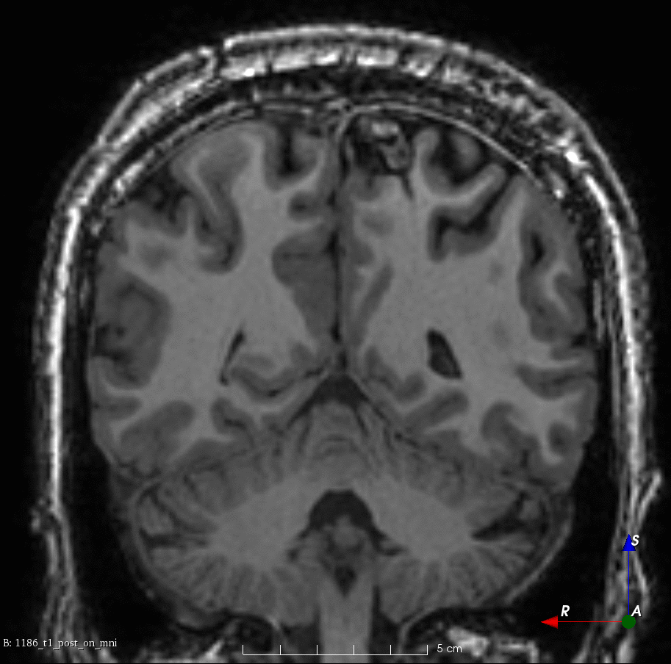
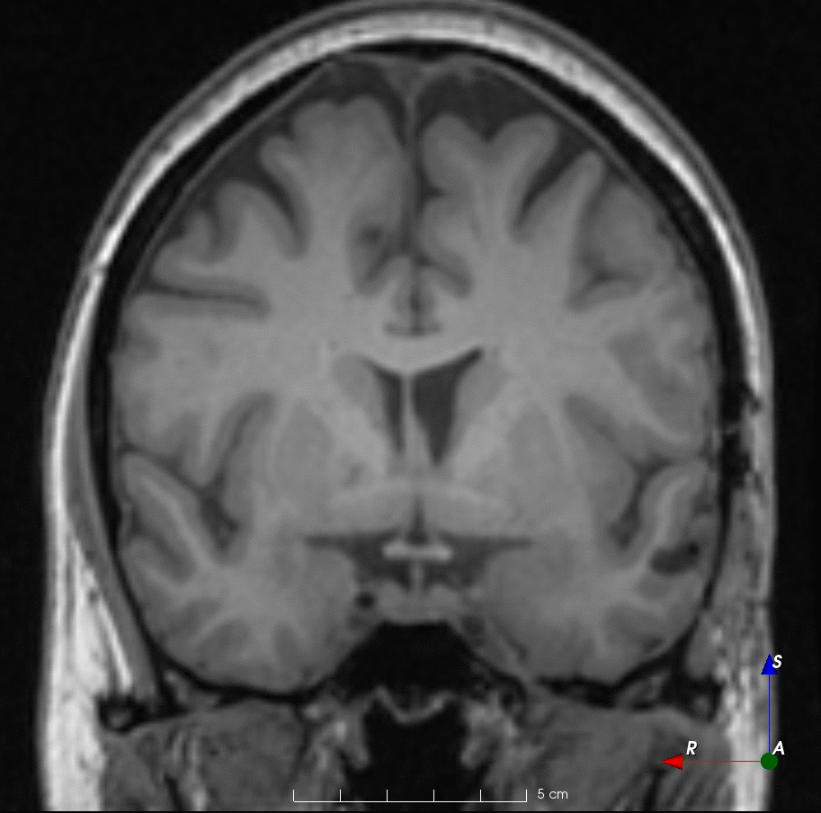
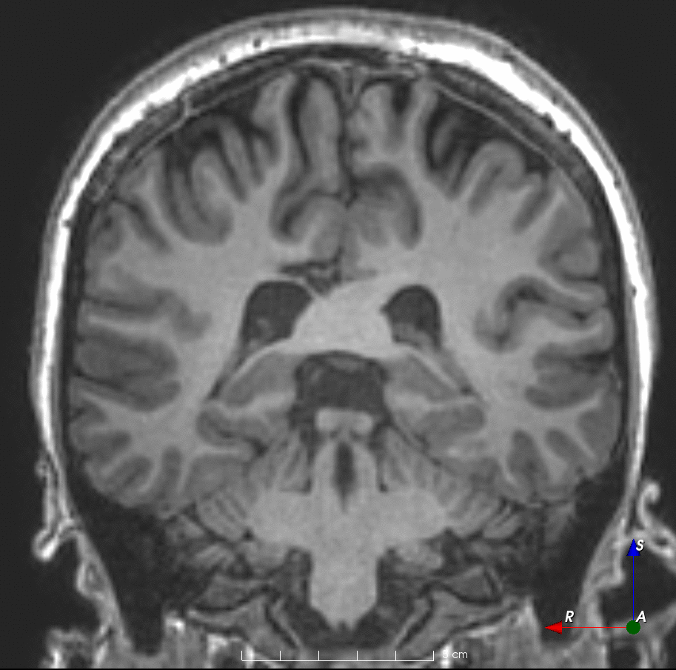
Label
Prediction
Results - qualitative (failures)
Notes:
1186
0880
1044

Slide 18
^{Conclusions}
Using more data is beneficial
Manual labels not needed if
Self-supervision on similar domain
Large dataset

Slide 19
^{Limitations}
No ground truth
Raters are not neuroradiologists
Only tested on a single centre dataset (EPISURG)
Brain shift not modelled

Slide 20
^{Future work and research plan}
Conference paper (MICCAI)
Inter-rater variability
Journal paper + dataset on UCL Research Data Repository
Better modelling
Registration
Validation
Deployment
Reproducibility
Video

Slide 21
^{Thank you!}
Deep learning for video-telemetry
^{and MRI processing in epilepsy}
Fernando Pérez-García, Rachel Sparks, John Duncan, Sébastien Ourselin
EPSRC Centre for Doctoral Training in Intelligent, Integrated Imaging In Healthcare (i4health)
MPhil upgrade day
19 February 2020
@fepegar
@fepegar_
DOI: 10.5522/04/11828637
fernando.perezgarcia.17@ucl.ac.uk

